Slide 1
Impacts of welfare changes in Camden
October 2015
(HB ref date 1 Oct-15)

Slide 2
Housing Benefit Overview
There has been a 20% decrease in the number of new claims received since 2011/12.
Housing Benefit (HB) claimants constitute around a quarter of Camden households.
69% of claimants are working aged, and most of these will be affected by Universal Credit.
Notes:
Total Claims (monthly average in year): Based on QV dashboard (ref. date 1.10.15)
New Claims: Provided by Alan Porter (Oct-15)
Claims by tenure: Provided by Alan Porter (Oct-15)
Change in the number of HB claimants: Provided by Alan Porter (Oct-15)

Slide 3
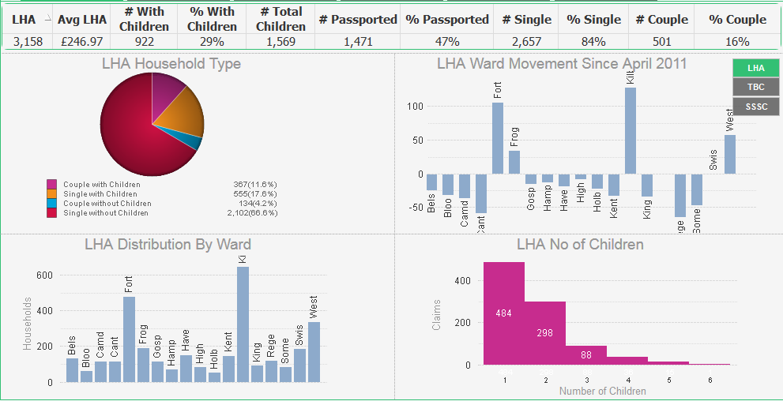
Local Housing Allowance (LHA) Overview – Oct-15
3,158 residents claiming LHA, on average receiving £246.97 per week
1,569 children across Camden live in households claiming LHA
2,657 single adult households in Camden claim LHA. This is 84% of all households
The highest concentration of single adult claimants (515), including lone parents (135), is in Kilburn.
Kilburn has seen the highest increase (127) in households on LHA, up from 516 in April 2011, to 643 in October 2015.
Kilburn has 241 households containing 463 children, meaning it is has the most children affected by LHA in Camden.
Regents Park (-64) has seen the largest fall in households claiming LHA since April 2011.
Kilburn has the highest number of households on LHA in Camden with 643, compared to 53 households in Holborn & Covent Garden which has the lowest number in the borough.
484 HHs with 1 child (484)
298 HHs with 2 (596)
88 HHs with 3 (264)
36 HHs with 4 (144)
15 HHs with 5 (75)
1 HH with 6 (6)
Notes:
Based on QV dashboard (ref. date 1.10.15)

Slide 4
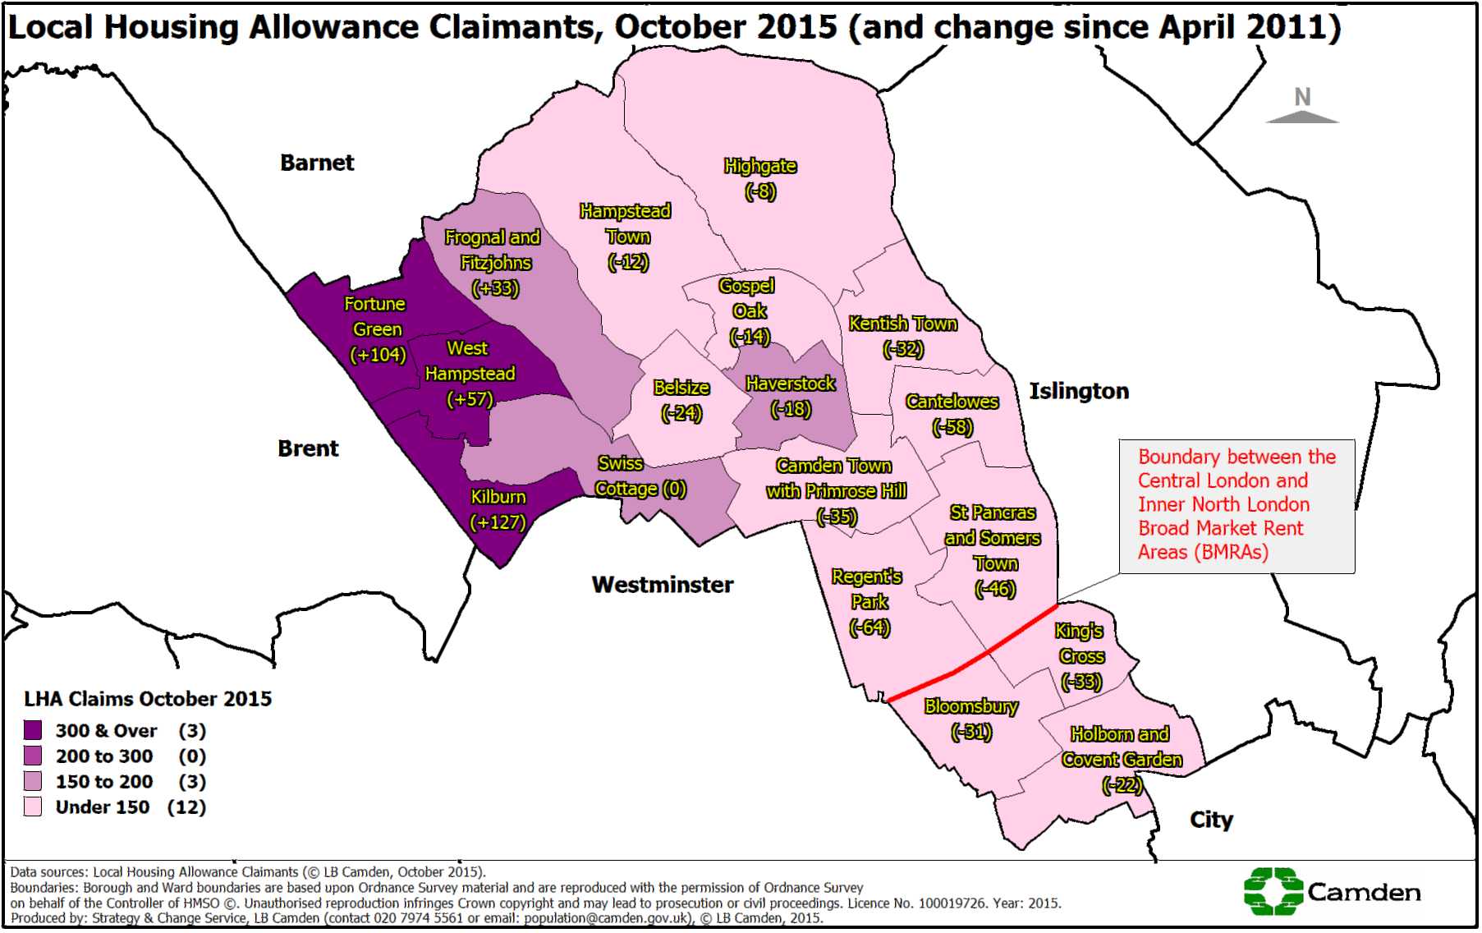
Notes:
Based on QV dashboard (ref. date 1.10.15)

Slide 5
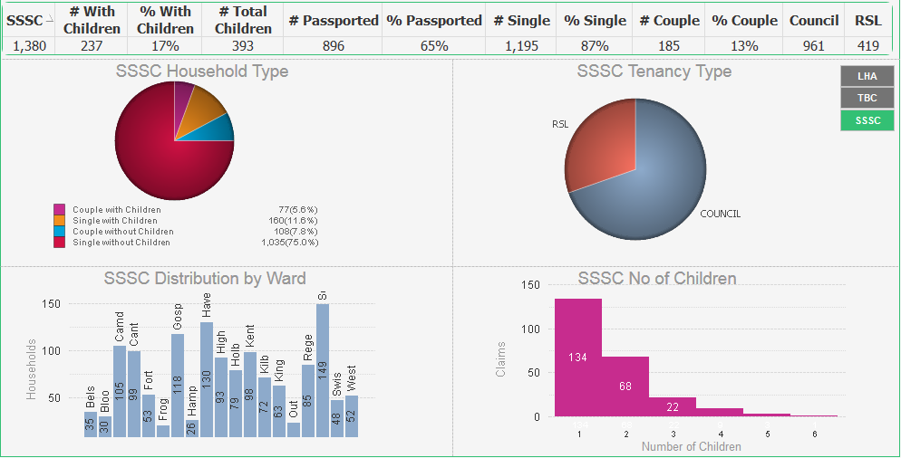
Social Sector Size Criteria (SSSC) – Overview Oct-15
1,380 households in Camden are affected by SSSC and on average lose £22.39 per week
Overall, 407 children across Camden live in homes affected by SSSC.
254 of the households in Camden affected by SSSC have children.
1,271 households affected by SSSC are occupied by single adults. 176 of these have children.
427
1,028 of Camden residents affected by SSSC live in council accommodation. 427 live in housing provided by a Registered Social Landlord (RSL)
1,028
St Pancras & Somers Town is one of the most affected ward, with 160 households, including 63 children impacted
This table shows the number of children by SSSC household. i.e.
152 households with 1 child,
66 households with 2 children, etc.
The least impacted ward is Frognal & Fitzjohns, with 24 households affected
Notes:
Based on QV dashboard (ref. date 1.10.15)

Slide 6
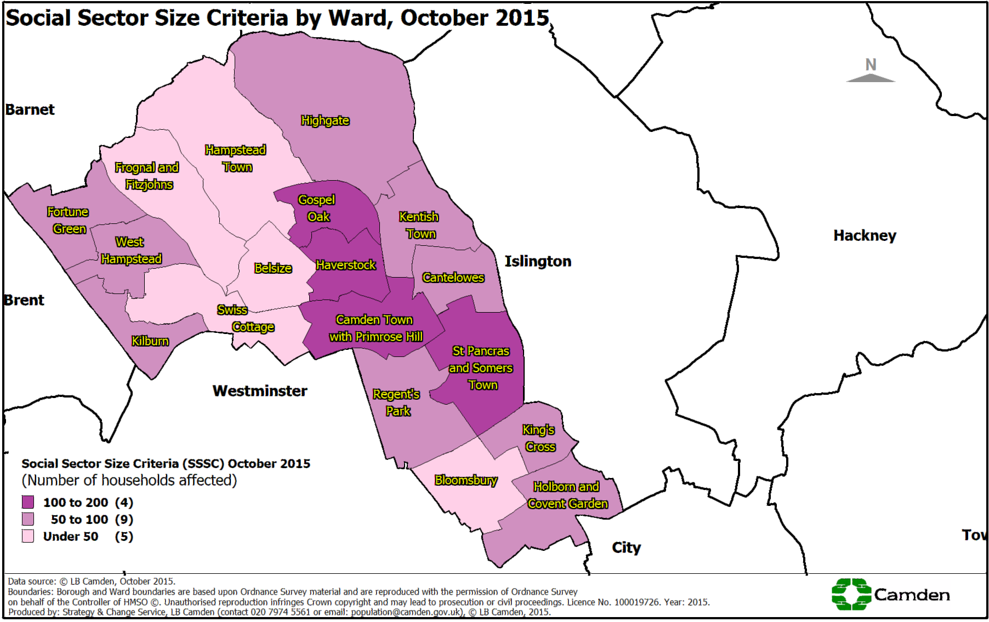
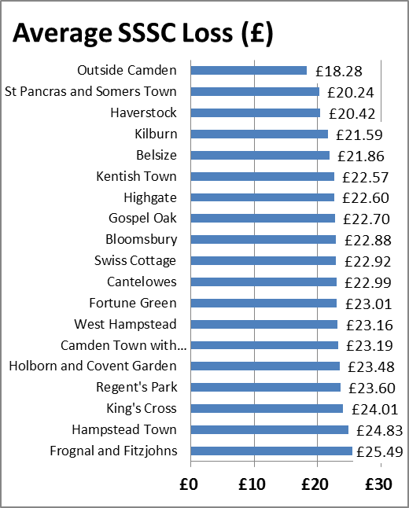
The lowest average loss is £20.24 p/w is in St Pancras and Somers Town.
The highest average loss is £25.49 p/w is in Frognal & Fitzjohns.
Notes:
Based on QV dashboard (ref. date 1.10.15)

Slide 7
SSSC: Council Tenancies in Arrears
SSSC Arrears
Sep-15, week 22
531 (53%) SSSC tenants are in arrears
94 (9.4%) owed over £1,000. Of these:
- a third are in difficulty, but being helped
- a third are reducing their arrears
- a third are intermediate, falling in and
out of the £1,000+ group as arrears
go up and down
Assistance being provided to mitigate risk
21 currently awarded (DHP)¹
10 on DLA/PIP²
25 supported by FSS/TST³
39 received debt/benefit/money management advice:
- 16 debt/benefits advice from WRT⁴
- 23 from the Money Advice Service
  Discretionary Housing Payments
  Disabled Living Allowance/Personal Independence Payment
  Floating Support Service/Tenancy Support Team
  Welfare Rights Team
Notes:
HASC In-depth analysis (provided 5 Oct-15).

Slide 8
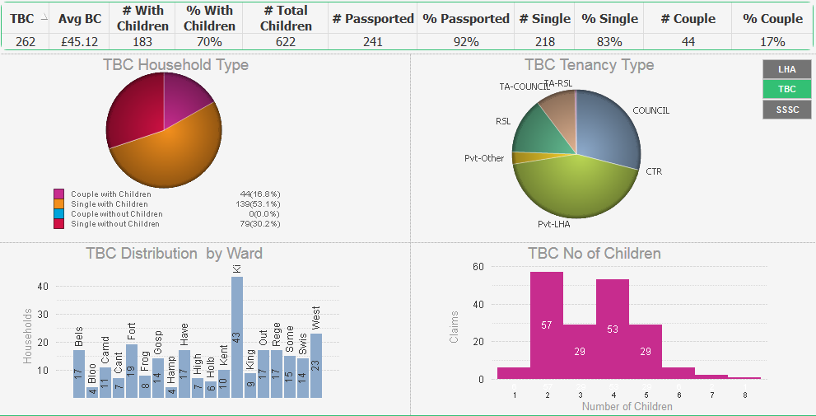
Total Benefits Cap (TBC) Overview Oct-15
262 households affected in October 2015, 183 of these contain children.
£45.12 per week average benefit loss
635 children affected by TBC across Camden.
The highest number these children, 92, live in Kilburn
80 single adult households are affected. The highest concentration of single adults affected live in Kilburn (39), including lone parents (13),
29
3
72
33
10
0
Majority of households affected by TBC live in Private Rented Sector (130)
120
This table shows the number of TBC households by number of children, i.e. there are 56 households with 2 children affected by TBC, 44 households with 4 children affected, etc.
Highest concentration of households affected (48) in Kilburn
Lowest concentration of households affected (3) in Bloomsbury
Notes:
Based on QV dashboard (ref. date 1.10.15)

Slide 9

Total Benefits Cap (TBC) – Continued
TBC Household profile
Total Households
262
Couples with
children
44
Single with
children
139
Households with
children
183
Single Adults
218
Single without
children
79
Households without children
79
There are currently 262 TBC cases in Camden.
Couples without children
0
What happened to the October 2013 TBC cohort?
TBC Arrears (September 2015)
69 cases
8 owe £500+
5 owe £1,000+
High arrears cases characterised by: large families with young children and babies; with a lone parent mother; more from Bangladeshi and Somali groups
314
In payment
57
No longer claiming housing benefit in the borough
84
In payment -
No longer affected by TBC
Number of Claimants
173
In payment -
Still affected by TBC
October 2013 October 2015
Notes:
TBC Households by number of children and TBC Profile: Based on QV dashboard (ref. date 1.10.15)
TBC Oct-13 cohort update: Alan Porter (Oct-15).
TBC arrears: Cornelia Bickersteth, Housing Management (Sep-15).

Slide 10
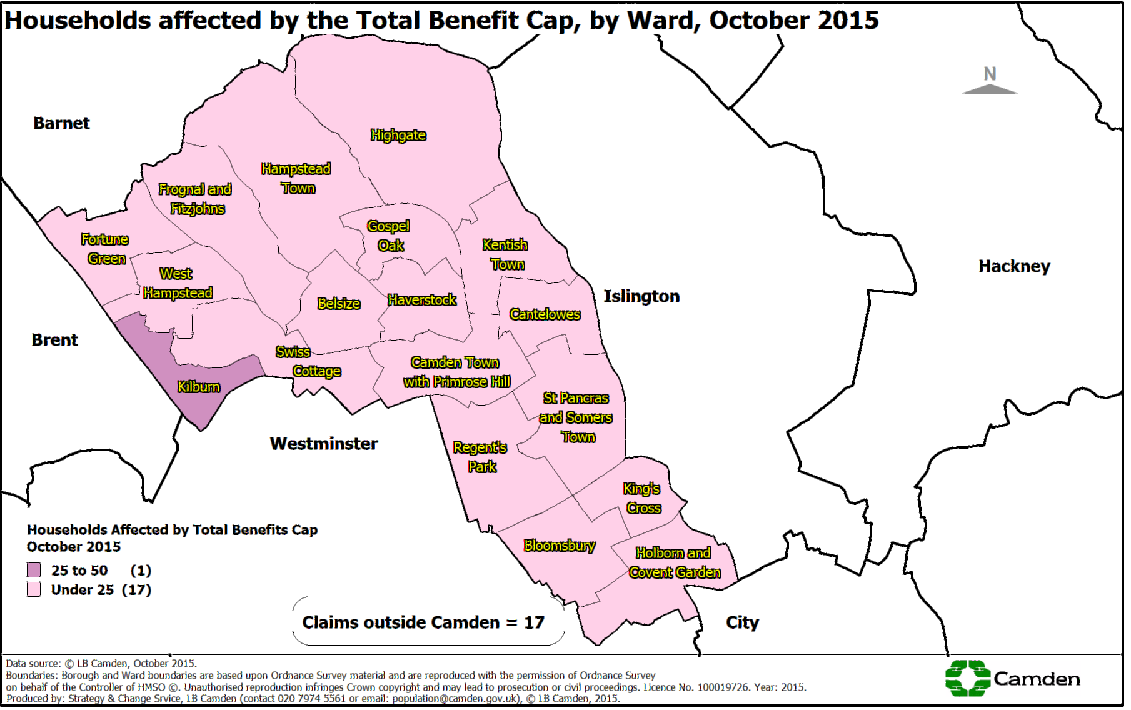
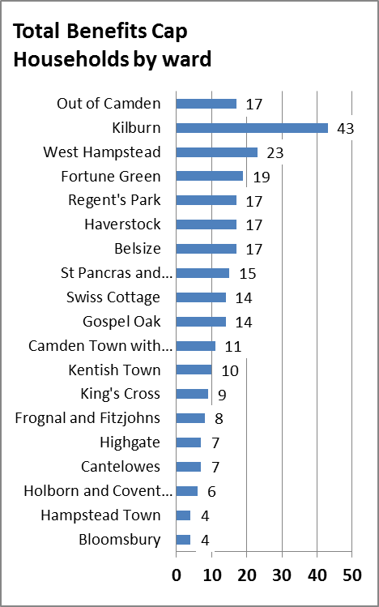
Notes:
Based on QV dashboard (ref. date 1.10.15)

Slide 11
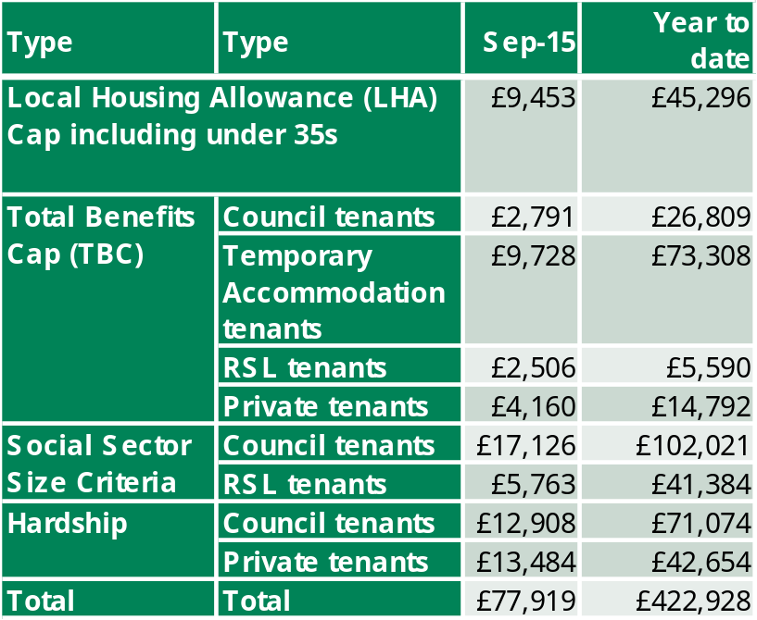
Discretionary Housing Payments (DHP) Spend 2015-16
Discretionary Housing Payments are one of the main tools at the Council’s disposal to mitigate the impact of welfare changes and the funding allocated by the Department for Work and Pensions (DWP) to Camden has increased accordingly. Spend has more than doubled since the Total Benefits Cap (TBC) came into effect.
The largest number of people who receive DHP are 359 tenants impacted by the SSSC. Last month, they were paid £32,825 and have received £199,904 in the year to date.
The difference between HB and rent is significant for private tenants. This is due to the Local Housing Allowance (LHA) caps. Although new claims have fallen in Camden, claimants who are already in private properties are finding it hard to cope financially. Claimants circumstances are such that for them to sustain the tenancy the Council has to pay DHP to cover the difference.
Total Received YTD = 684
Notes:
Updated with figures from Alan Porter (Oct-15).

Slide 12
Council Tax Reduction Scheme (CTRS)
Council Tax Reduction Scheme (CTRS) covers 91.5% of Council Tax liability.
All households affected by one or more of the housing benefit changes will also be affected as nearly all households that receive Housing Benefit also receive CTRS.
CTRS: Number of Claimants in Camden
 | 01-Apr-14 | 01-Oct-15 | Change | %
Non-Working | 11,338 | 10,617 | -721 | -6.4%
Working | 5,180 | 4,977 | -203 | -3.9%
Pension Credit | 6,182 | 6,045 | -137 | -2.2%
Other Pensioners | 2,289 | 2,143 | -146 | -6.4%
Total | 24,989 | 23,782 | -1,207 | -4.8%
In October 2015, 23,782 households in Camden received CTRS.
The number of households in receipt of CTRS has fallen overall since April 2014 by 1,207(-3%) and across all claim types. The largest change by claim type is for non-working households with a fall of 721 (-6.4%). By proportion this matched the fall by Other Pensioners not on Pension Credit which has reduced by 146 households (-6.4%). Working households fell by 203 (-3.9%) and those on Pension Credit fell by 137 (-2.2%). Note that people in work are no longer affected by TBC and can claim tax credits.
Notes:
Updated with figures from Alan Porter (Oct-15).

Slide 13
Impacts of Housing Benefit (HB) reform: Council rent arrears
Arrears rates for households affected by the SSSC is higher than average suggesting they may be struggling to cope financially with the reductions to their housing benefit.
Group | Number | Arrears rate | Average arrears amount
All tenants (excluding TMOs)* | 22,840 | 43.5% | £460
HB claimants | 14,951 | 42.7% | £363
Affected by SSSC | 999 | 53.0% | £614
Affected by TBC | 69 | 81.0% | £421
* TMOs = Tenant Management Organisations – see note below
Data as at 6 September 2015
Note the arrears rates include all tenants who are in arrears no matter how small the amount. Overall only a small proportion of tenants are in significant arrears. 5.2% owe more than £1,000, up from 4.5% in July 2014).
The general increase in arrears may also be due to other factors, principally the council taking over the rent collection for a number of Tenant Management Organisations during 2013 many of whose accounts were in arrears
The rate for SSSC-affected households was higher than for all tenants when it was introduced - 42% compared to 36% for all tenants. It has since increased further to 53% on October 2015. This continues to suggest that these households are struggling to cope with their reduced income. The average amount of arrears is also higher than for other households.
This makes the support (such as DHPs) offered by the council, to ensure these households can maintain their tenancies, all the more important.
Notes:
Update provided by Minaxi Patel on 13 Oct-15.

Slide 14
Impacts of HB reform: Homelessness and Temporary Accommodation
There were 4 homelessness acceptances in August 2015.
The average of monthly acceptances is falling: 7.3 in 2013, 5.2 in 2014 and 4.5 in 2015 (to August).
There were 454 households in Temporary Accommodation (31 Aug-15). This is 176 fewer (-28%) than in July 2013.
Notes:
Data provided by Minaxi Patel. PtVII homeless acceptances figures for Aug-15.

Slide 15
Future Changes
Further reductions to the Total Benefit Cap
It is proposed to reduce the Total Benefit Cap to £23,000 per year in London. We are waiting for details of when and how this will be applied before estimating the impact.
Universal Credit
Universal Credit will start in Camden from the 14 March 2016. Initially only new claims from single job seekers without a disability will be taken. Other types of claimants will be added during 2016/17.

