Slide 1
Population Growth
MARCH 2016
This factsheet focuses on future population growth and changes in demographics, with data from the 2014 GLA population projections ‘Camden Development (capped average household size)’.
Understanding the changes in size and characteristics of Camden’s population, as well as broken down by segment helps us plan healthcare resources and service delivery effectively for each group, as well as the population in general.
This forecast uses the ONS mid-year estimate at mid-2011 as a base; this estimate includes all people who usually live in an area, regardless of nationality. Arriving international migrants are included in the usually resident population if they remain for at least a year and emigrants are excluded if they remain outside the UK for at least a year. Students are taken to be usually resident at their term-time address. The 2014 GLA population projections ‘Camden Development (capped average household size) includes an element of planned housing development.
Camden’s estimated usual resident population in 2015 is 237,400
Population projections suggest that there will be around 20,900 new residents by 2025, a 9% increase. This is similar to the London average increase of 10%.
In 2015 the under 18 year old population in Camden was approximately 40,000, and approximately 23,000 are aged 65 or over. The proportion of population aged 65 or over is projected to increase from 11% in 2015 to 15% in 2025.
Approximately 64% (149,000) of residents are White (72% in 65+ population), 16% (36,000) are Asian and 10% (24,000) are Black. The proportion of the White population is projected to decrease from 65% in 2015 to 62% in 2025.

Slide 2


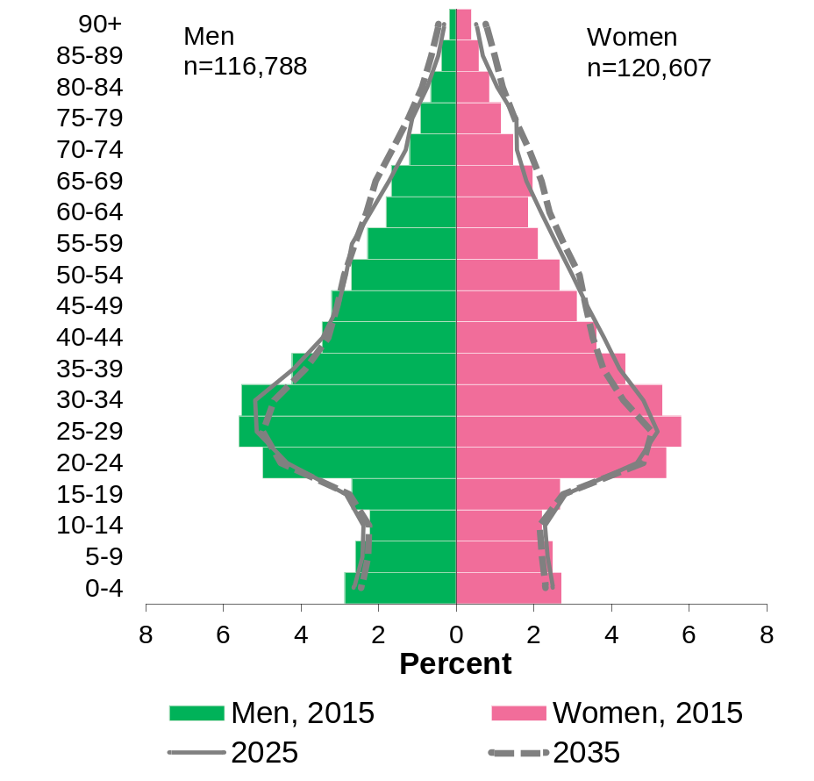

SETTING THE SCENE: THE CAMDEN PICTURE
How big is Camden’s population at the moment?
Population pyramid showing the proportion of the Camden resident population by five yearly age groups, 2015 compared with 2025, 2035
237,400
Camden’s estimated usual resident population, in 2015.
The GLA estimates suggest that the age profile of Camden is slowly changing, aging along with the rest of the country:
104,600
households in the borough, in 2015.
How is the population expected to change?
9,850 (21%)
More residents aged 45-64 by 2025
20,900 estimated new residents by 2025, a 9% increase
This will include 11,770 new households.
6,100 (23%)
More residents aged 65+ by 2025
Chinese (2,100 increase, 27%) and
Other Asian (3,200 increase, 21%) groups are estimated to have the largest percentage increases by 2025
4,550 (37%)
More residents aged 75+ by 2025
White (5,700 increase, 3.8%) and
Black (2,100 increase, 9.1%) groups are estimated to have the smallest
percentage increases by 2025
Source: GLA 2014 Round Population Projections 'Camden Development, capped AHS': Population (single years of age)
Notes:
Population pyramid or the Age2 stacked bar chart down this side of the page to show the aging population?

Slide 3
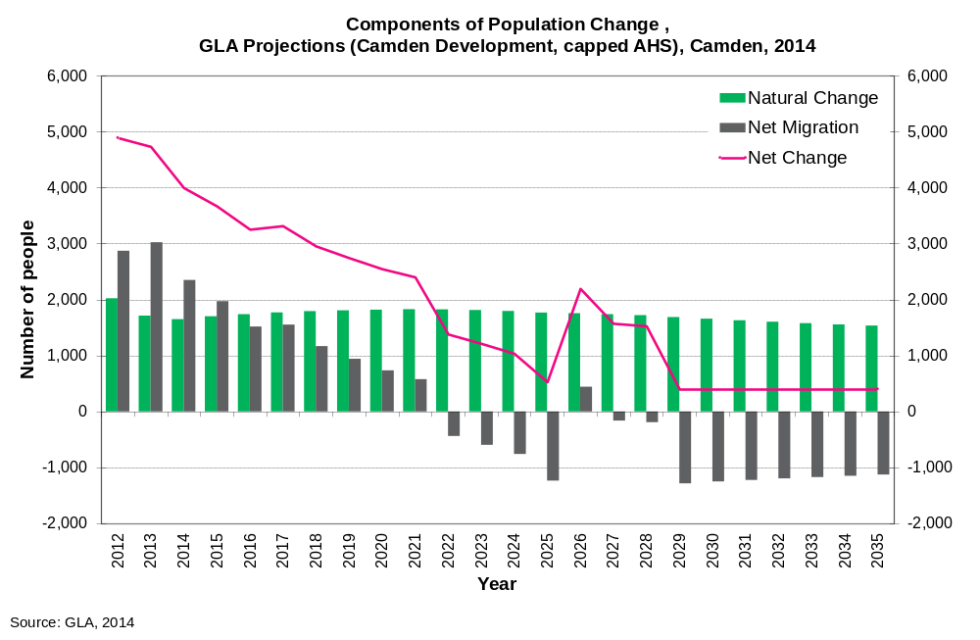

SETTING THE SCENE: THE CAMDEN PICTURE
The number of births in Camden had been rising but the previous two years has seen a fall in births, mirroring the London and national trend.
The pace of population change likely to slow in coming years due to the housing shortage in Camden.
Camden maintains a relatively young age structure due to the steady flow of student-age population coming in and out of the borough each year.
Camden’s estimated annual net population change was +3,700 people in 2015
Due to negative net migration projections Camden’s annual net change is estimated to be +530 people in 2025
The GLA round population projections are produced using a cohort component projection model (based on previous trends in migration, fertility and mortality) but this model does not allow for planned housing nor available development areas. The GLA recommend Camden Development (capped average household size) as the best scenario, this population forecast is based on projections and includes planned development changes.
For more information see Camden GLA 2014 technical analysis paper: https://opendata.camden.gov.uk/download/ghrqnmra/application/pdf
Notes:
Do:
Include numbers and rates where possible.
Make comparisons with England (or NE) and appropriate ‘benchmark’ areas or groups.
Make data displays easy to comprehend
Indicate where levels of need are unknown.
Don’t:
Guess at numbers if there is no evidence.
Include large data tables.
Include graphs that display only one or two data items.
Include irrelevant data just to fill space

Slide 4
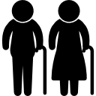


FUTURE NEED
Population projections suggest that there will be around 20,900 new residents by 2025, a 9% increase. This is similar to the London average increase of 10%.
These estimates also show how Camden’s population will have an older profile by 2025, with 6,100 (23%) more residents aged 65+ by 2025
Estimates show that in total, 1,558 adults (6.6%) have dementia; this includes the undiagnosed population.
Of these, approximately 1,071 people aged 65+ have been diagnosed with dementia in Camden, equating to a prevalence of 4.5%
If this prevalence rate stays the same, the population growth would equate to an estimated increase of 1,100 additional people aged with dementia by 2035.
This will have implications for health and social care provision in key groups, with the profile of long term condition diagnoses changing and demanding increasing in key areas.
There are currently 610 people aged 65+ diagnosed with cancer in Camden, equating to a prevalence of 2.5%.
This equates to an estimated increase of 160 people aged 65+ diagnosed with cancer by 2025, at the current prevalence rate.
This underlines the importance of prevention and lifestyle interventions.
There are currently 3,668 people (1.4%) diagnosed with a serious mental illness (SMI) in Camden
This equates to an estimated increase of 500 additional cases of SMI by 2035, if the current prevalence rates stay the same.
The strong link between physical health and serious mental health underlines the importance of the movement towards integrated models of care that address both mental and physical health together

Slide 5
Demographics: Population Segmentation 2015, Camden JSNA
https://opendata.camden.gov.uk/Health/Camden-Demographics-Population-Segmentation-2015/v6fr-wght
Technical Analysis Paper: GLA 2014 Round of Demographic Projections, London Borough of Camden
https://opendata.camden.gov.uk/download/ghrq-nmra/application/pdf
GLA Demography Datastore:
http://data.london.gov.uk/demography/Camden
About Camden’s JSNA
Open Data Camden brings together information held across different organisations into one accessible place. It provides access to evidence, intelligence and data on the current and anticipated needs of Camden’s population and is designed to be used by a broad range of audiences including practitioners, researchers, commissioners, policy makers, Councillors, students and the general public.
This factsheet was produced by John Cannings (Public Health Information Officer) and approved for publication by Dalina Vekinis (Principal Public Health Intelligence Specialist).
Contact: JSNA@camden.gov.uk

