Slide 1
Impacts of welfare changes in Camden
May 2015

Slide 2
Housing Benefit Overview
There has been an 24% decrease in new claims since 2011/12. Housing Benefit claimants make up over a quarter of households in Camden. Most will be affected by Universal Credit.
Benefit claims of private sector tenants are sharply declining, where the private sector rents are higher than the LHA rates.
Notes:
Total Claims: Used QV dashboard (19.5.15) for most recent data. Alan Porter check OK.
New Claims: Provided by HB Team
Claims by tenure: Used QV dashboard (19.5.15)
Change in the number of HB claimants: Used QV dashboard (19.5.15)
Alan Porter checked OK.

Slide 3
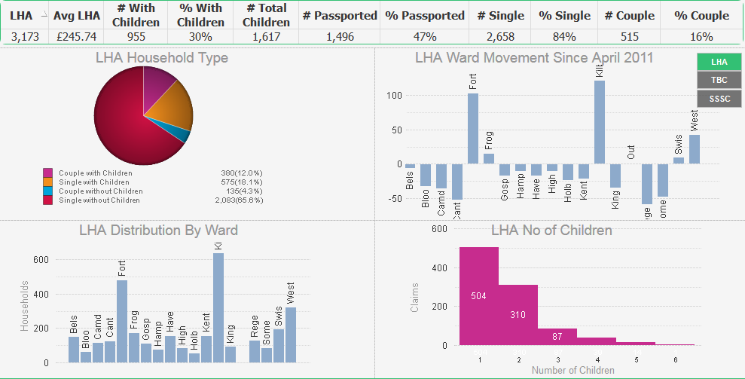
Local Housing Allowance (LHA) – An overview
2,658 single adult households in Camden claim LHA. This is 84% of all households
3,173 residents claiming LHA, on average receiving £245.74 per week
1,617 children across Camden live in households claiming LHA
May-15
The highest concentration of single adult claimants (503), including lone parents (133), are in Kilburn.
Kilburn has seen the highest increase in households on LHA, up from 516 in April 2011, to 637 in May 2015.
Kilburn has 239 households containing 456 children, meaning it is has the most children affected by LHA in Camden.
Regents Park has seen the biggest drop (-58) in households claiming LHA since April 2011.
Kilburn has the highest number of households on LHA in Camden with 637, compared to 53 households in Holborn & Covent Garden which has the lowest number in the borough.
This table shows the number of children by LHA household. i.e.
504 households with 1 child,
310 households with 2 children, etc.
Notes:
Used QV dashboard (19.5.15)

Slide 4
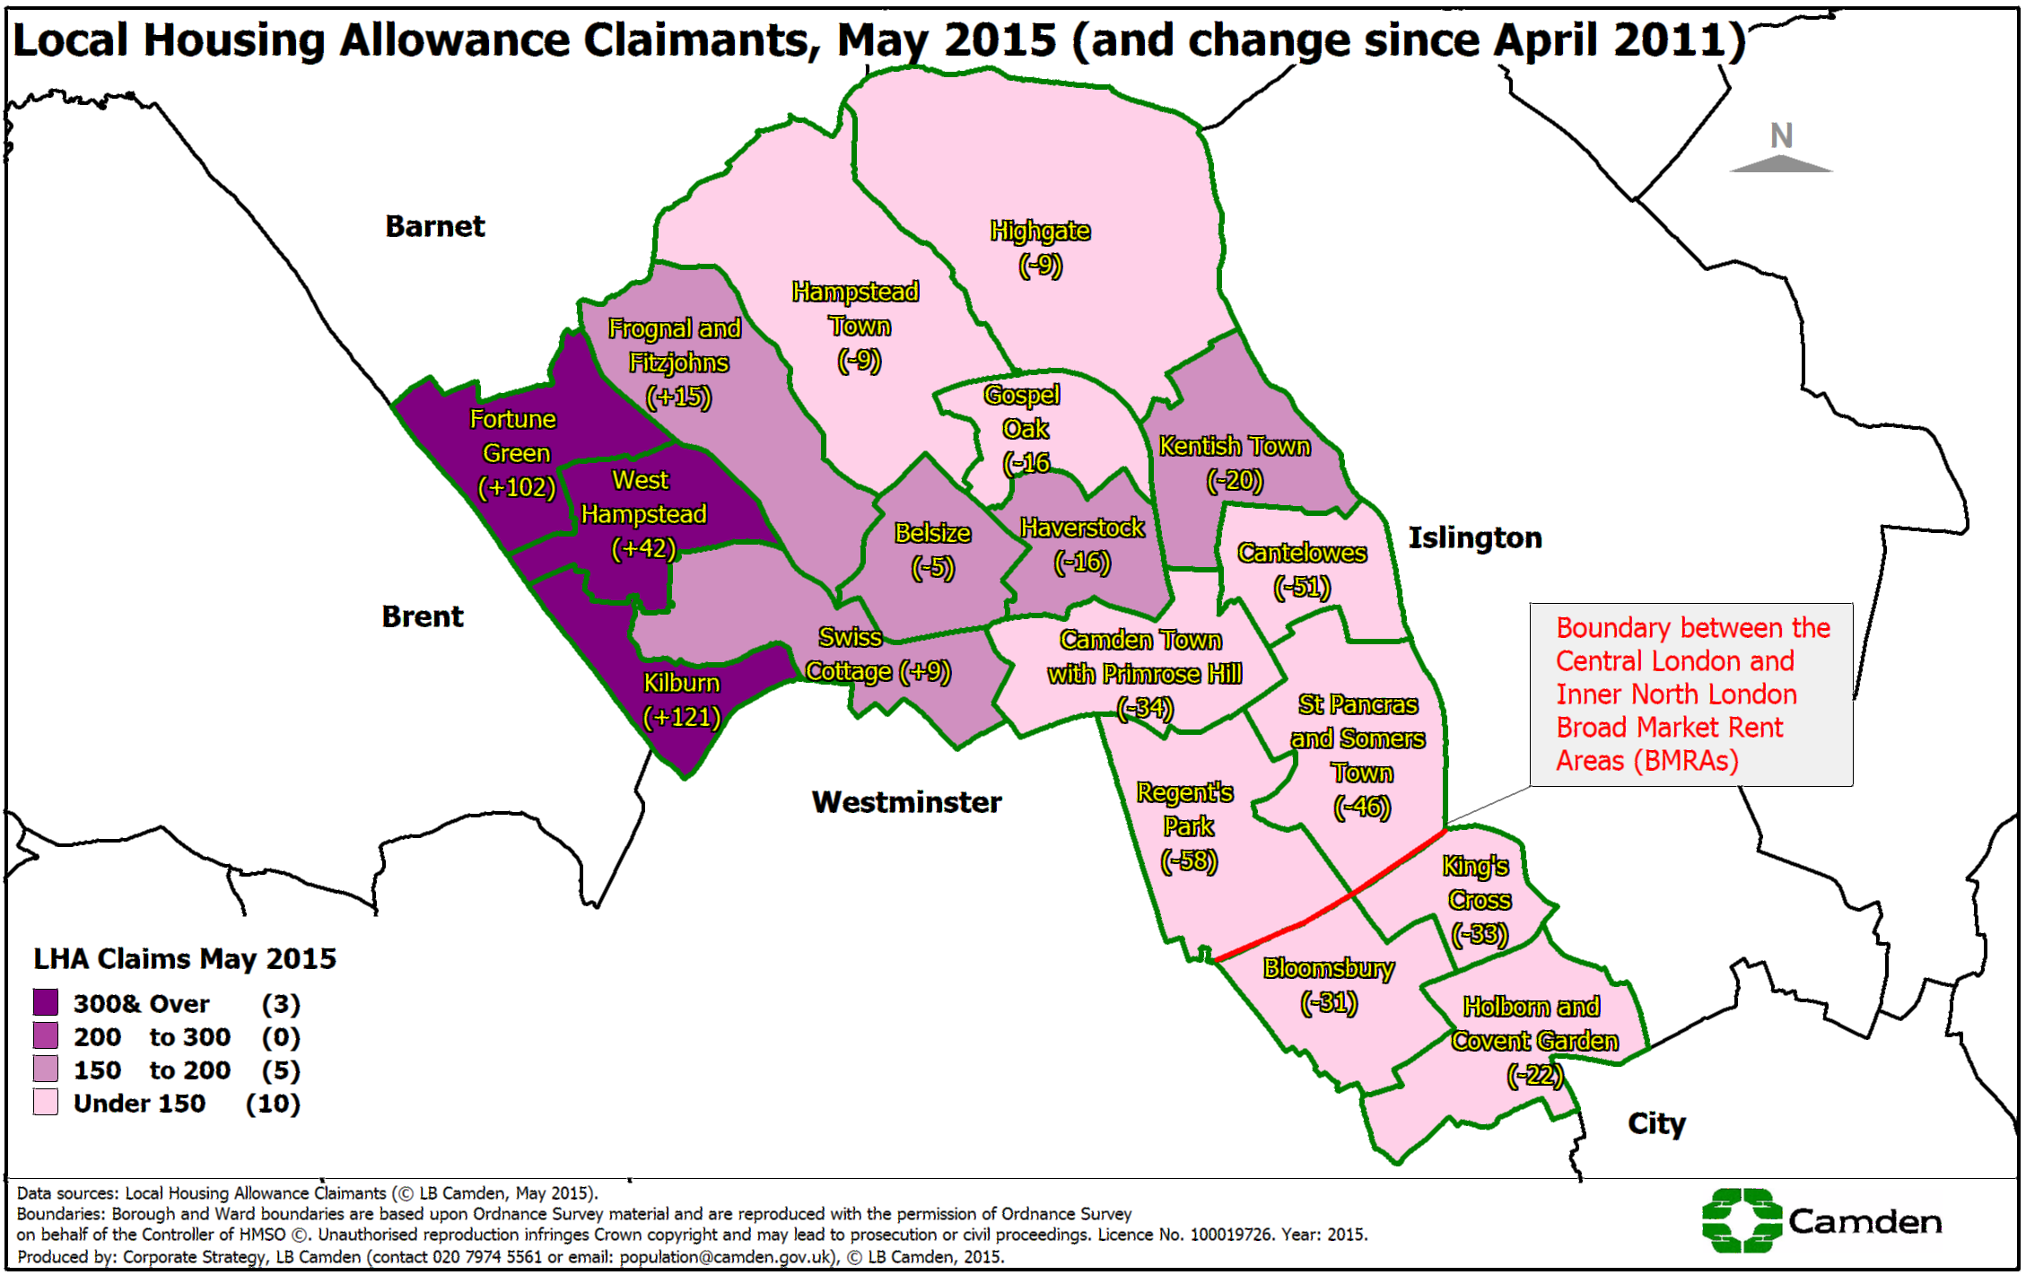
Local Housing Allowance (LHA) - Ward Map
Notes:
Used QV dashboard (19.5.15)

Slide 5
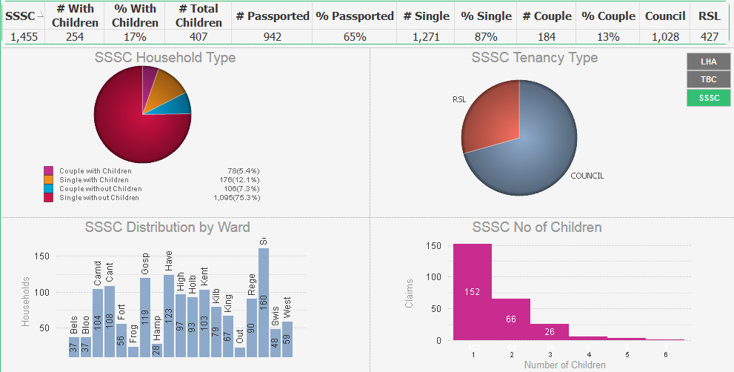
Social Sector Size Criteria (SSSC) – Overview May-15
1,455 households in Camden are affected by SSSC and on average lose £22.26 per week
Overall, 407 children across Camden live in homes affected by SSSC.
254 of the households in Camden affected by SSSC have children.
1,271 households affected by SSSC are occupied by single adults. 176 of these have children.
427
1,028 of Camden residents affected by SSSC live in council accommodation. 427 live in housing provided by a Registered Social Landlord (RSL)
1,028
St Pancras & Somers Town is one of the most affected ward, with 160 households, including 63 children impacted
This table shows the number of children by SSSC household. i.e.
152 households with 1 child,
66 households with 2 children, etc.
The least impacted ward is Frognal & Fitzjohns, with 24 households affected
Notes:
Used QV dashboard (19.5.15)

Slide 6
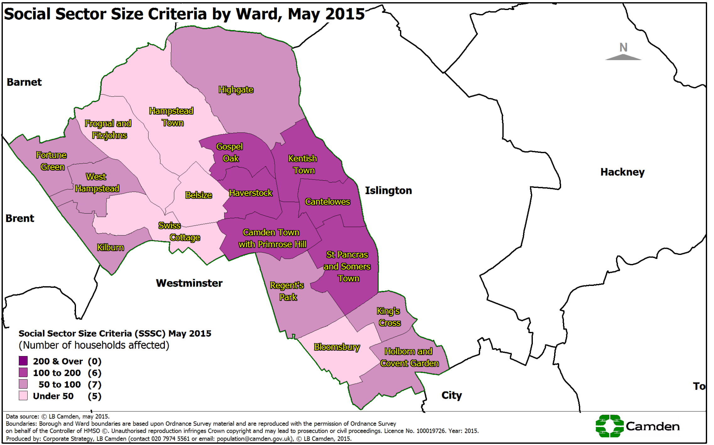
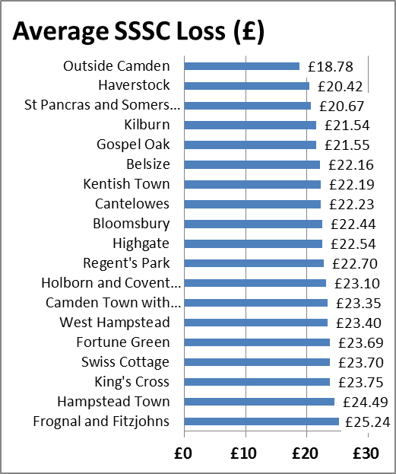
Social Sector Size Criteria (SSSC) – Ward Detail
The lowest average loss is £20.42 per week for households in Haverstock.
The highest average loss is £25.24 per week for households in Frognal & Fitzjohns.
Notes:
Used QV dashboard (19.5.15)

Slide 7
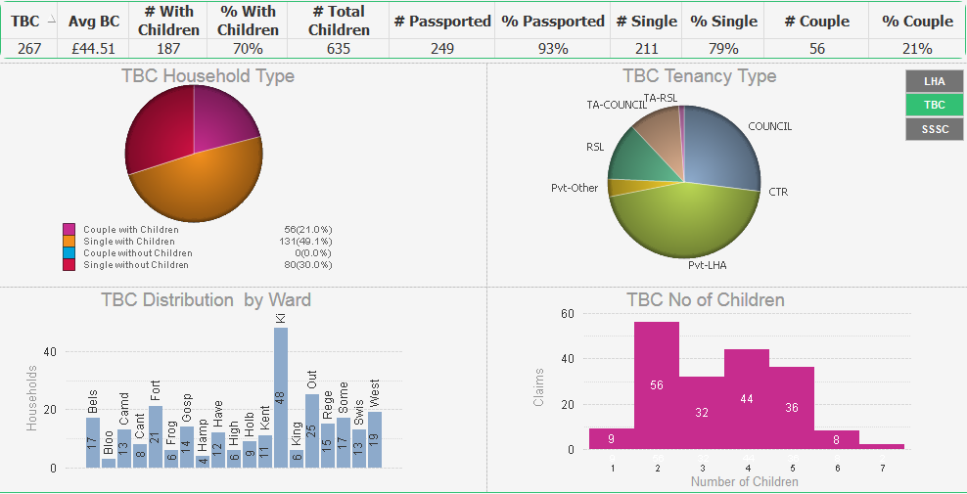
Total Benefits Cap (TBC)- An Overview May-15
267 households affected in May 2015, 187 of these have children.
£44.51 per week average benefit loss
635 children affected by TBC across Camden.
The highest number these children, 92, live in Kilburn
80 single adult households are affected. The highest concentration of single adults affected live in Kilburn (39), including lone parents (13),
29
3
72
33
10
0
Majority of households affected by TBC live in Private Rented Sector (130)
120
This table shows the number of TBC households by number of children, i.e. there are 56 households with 2 children affected by TBC, 44 households with 4 children affected, etc.
Highest concentration of households affected (48) in Kilburn
Lowest concentration of households affected (3) in Bloomsbury
Notes:
Used QV dashboard (19.5.15)

Slide 8

Total Benefits Cap (TBC) – Continued
TBC Household profile
Total Households
267
Couples with
children
56
Single with
children
131
Households with
children
187
Single Adults
211
Single without
children
80
Households without children
80
There are currently 267 TBC cases in Camden, with 142 new cases since October 2013
Couples without children
0
What happened to the October 2013 TBC cohort?
314
In payment
52
No longer claiming housing benefit in the borough
90
In payment -
No longer affected by TBC
Number of Claimants
172
In payment -
Still affected by TBC
October 2013 May 2015
Notes:
TBC Households by number of children and TBC Profile: Used QV dashboard (19.5.15)
TBC Oct-13 cohort update: HB Team

Slide 9
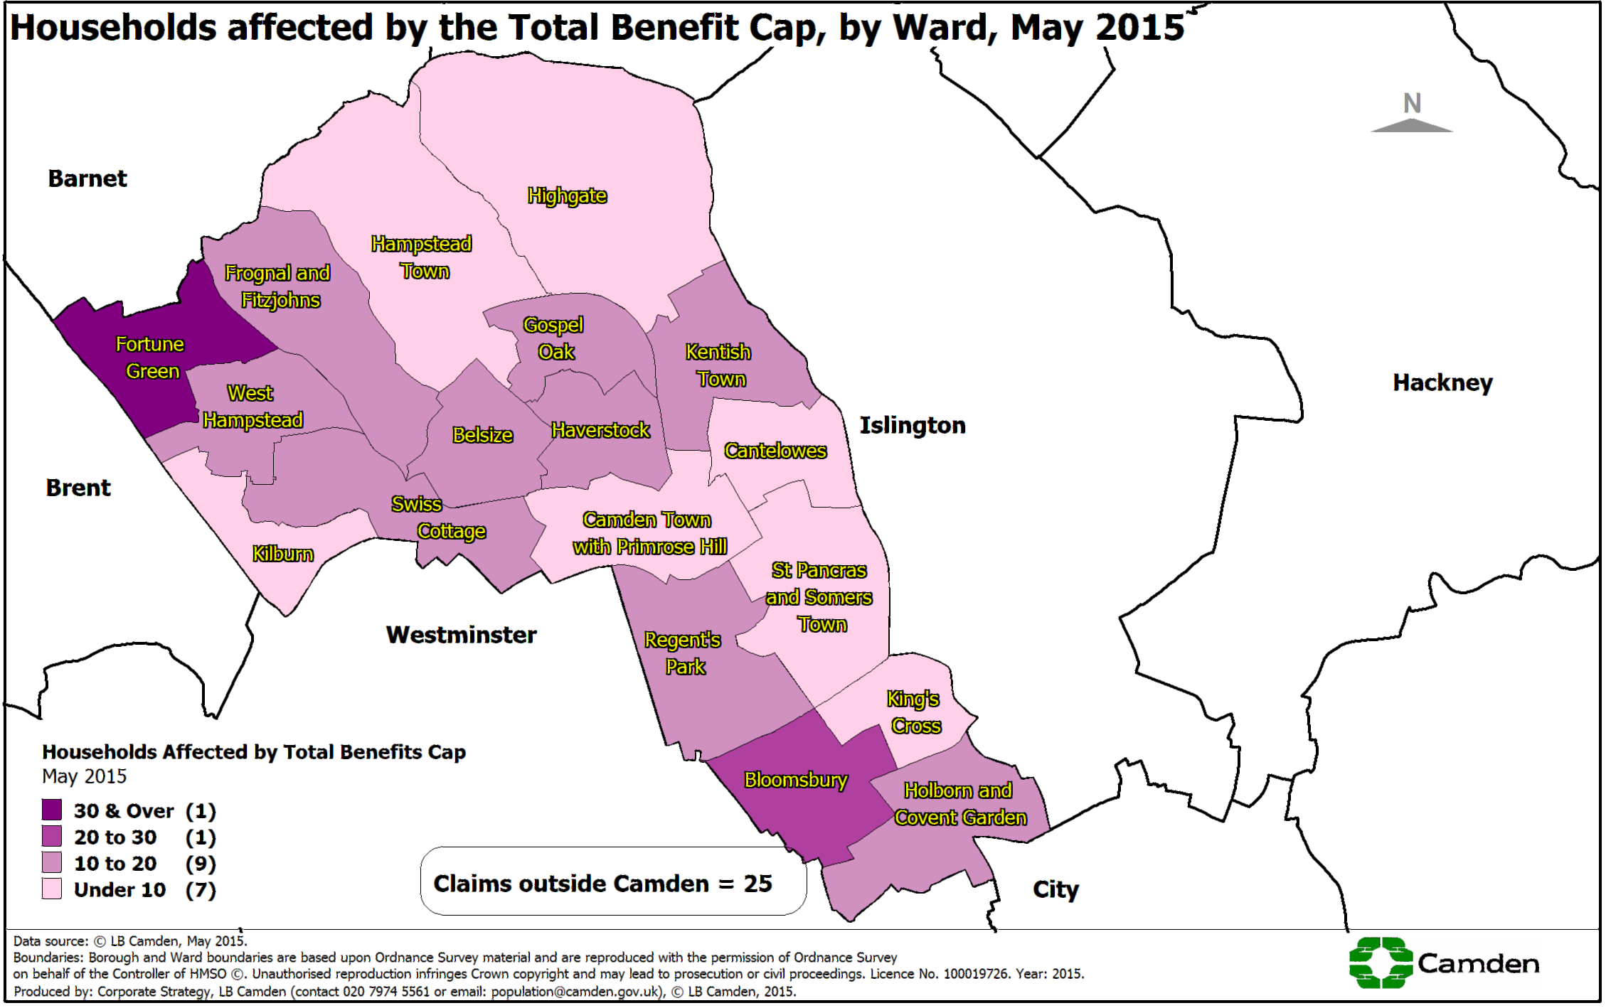
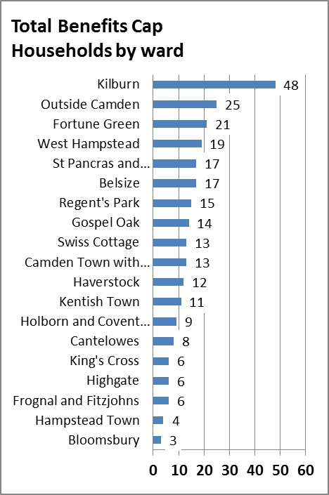
Total Benefits Cap (TBC) - Ward Map
Notes:
Used QV dashboard (19.5.15)

Slide 10
Discretionary Housing Payments (DHP) - Mitigating impact of Housing Benefit (HB) changes
Discretionary Housing Payments are one of the main tools at the Council’s disposal to mitigate the impact of welfare changes and the funding allocated by the Department for Work and Pensions (DWP) to Camden has increased accordingly. Spend has more than doubled since the Total Benefits Cap (TBC) came into effect.
Number of DHP claims have risen on average by 159% since 2010/11
Number of DHP Claims
There were 296 DHP claims April 2015.
The above table shows how much the council has spent on DHP and how much funding it has received from the DWP.
Expenditure has more than doubled due to introduction of total benefit cap.
Expenditure in 2014/15 was £1,224,974.
Notes:
DHP expenditure 2014/15 updated by Alan Porter (4 Jun-15)
DHP Claims not updated

Slide 11
DHP Monthly Spend 2015-16
Type | Type | May-15 | Year to date
Local Housing Allwance (LHA) Cap inc. under 35s |  | £4,335 | £12,127
Total Benefits Cap (TBC) | Council tenants | £7,067 | £8,267
 | Temporary Accommodation tenants | £14,618 | £20,982
 | RSL tenants | £763 | £1,161
 | Private tenants | £1,108 | £1,754
Social Sector Size Criteria (SSSC) | Council tenants | £22,529 | £31,590
 | RSL tenants | £5,085 | £14,618
Hardship | Council tenants | £10,053 | £16,773
 | Private tenants | £2,549 | £11,935
Total | Total | £68,107 | £119,207
Total Received YTD = 312
The largest number of people who receive DHP are 302 council tenants impacted by the SSSC. Last month, they were paid £39,649 and have received £56,630 in the year to date.
The difference in HB and rent is significant for private tenants. This is due to the Local Housing Allowance (LHA) caps. Although new claims have fallen in Camden, claimants who are already in private properties are finding it hard to cope financially. Claimants circumstances are such that for them to sustain the tenancy the Council has to pay DHP to cover the difference.
Notes:
Updated with figures from Alan Porter (4 Jun-15)

Slide 12
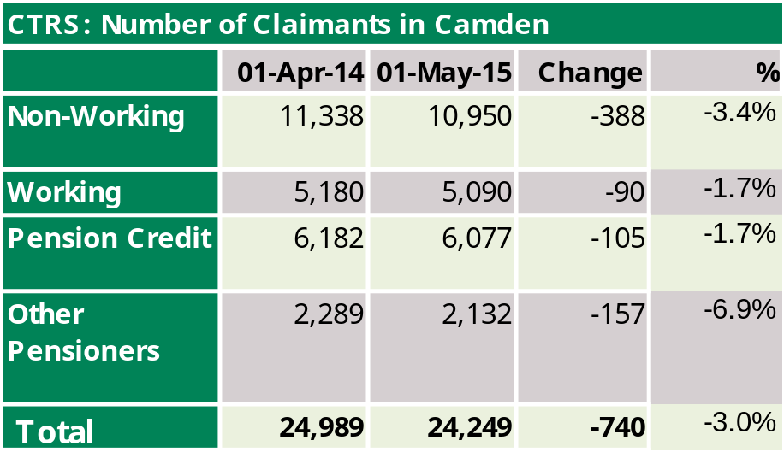
Council Tax Reduction Scheme (CTRS)
Council Tax Reduction Scheme (CTRS) covers 91.5% of Council Tax liability after any discount
There are 11,501 working age households paying between £1 and £5 per week
All households affected by one or more of the housing benefit changes will also be affected as nearly all households that receive Housing Benefit also receive CTRS.
In May 2015, 24,249 households in Camden received CTRS.
The number of households in receipt of CTRS has fallen overall since April 2014 by 740 (-3%) and across all claim types. The largest change by claim type is for non-working households with a fall of 388 (-3.4%). However, the largest fall by proportion is amongst Other Pensioners not on Pension Credit reduced by 157 households (-6.9%). Working households fell by 90 (-1.7%) and those on Pension Credit fell by 105 (-1.7%). Note that people in work are no longer affected by TBC and can claim tax credits.
Notes:
Updated with figures from Alan Porter (4 Jun-15).

Slide 13
Impacts of Housing Benefit (HB) reform: Council rent arrears
Arrears rates for households who will be affected by the SSSC is higher than average suggesting they may be struggling to cope financially with the reductions to their housing benefit.
Group | Number | Arrears rate | Average arrears amount
All tenants (excluding TMOs)* | 22,867 | 40.2% | £462
HB claimants | 15,191 | 40.0% | £368
Affected by SSSC | 1,003 | 52.0% | £504
Affected by TBC | 61 | 62.0% | £424
* TMOs = Tenant Management Organisations – see note below
Data as at 31 May 2015
Note the arrears rates include all tenants who are in arrears no matter how small the amount. Overall only a small proportion of tenants are in significant arrears. 7.7% owe more than £1,000 but up from 4% in July 2014).
The general increase in arrears may also be due to other factors, principally the council taking over the rent collection for a number of Tenant Management Organisations during 2013 many of whose accounts were in arrears
The rate for SSSC-affected households was higher than for all tenants before it was introduced and increased by 11 percentage points to July 2014. It has increased a further 6 percentage points by May 2015. This continues to suggest that these households are struggling to cope with their reduced income. The average amount of arrears is also higher than for other households.
This makes the support (such as DHPs) offered by the council to ensure these households can maintain their tenancies all the more important.
Notes:
Updates provided by Ken Robson (all tenants and HB claimants) and Per Sellberg (SSSC and TBC) on 9 June 2015.

Slide 14
Impacts of HB reform: Homelessness and Temporary Accommodation
There were 5 homelessness acceptances in May-15.
The average of monthly acceptances is falling: 7.3 in 2013, 5.2 in 2014 and 5.0 in 2015 (to May).
At the beginning of June 2015, there were 475 households in Temporary Accommodation (TA). This is 52 fewer (-10%) than in June 2014 and 155 fewer (-25%) than in July 2013.
Notes:
Data provide by Faisal Butt and Minaxi Patel. PtVII homeless acceptances figures for Aug-14 processed late and added in with Sep-14.

Slide 15
Government’s planned changes to housing benefit

Slide 16
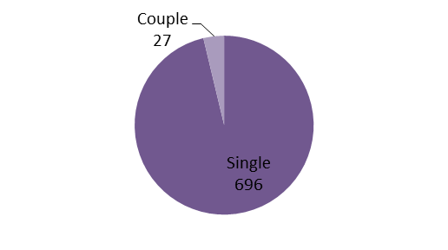
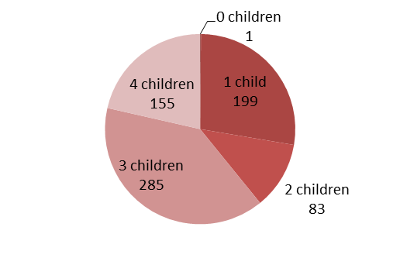
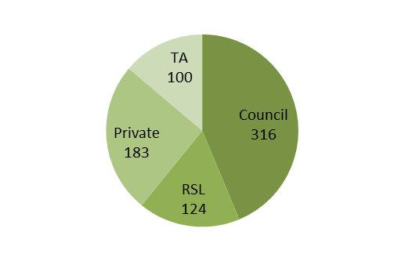
Total benefit cap reduced to £23,000
A maximum of 723 additional Housing Benefit claimants could be affected
The actual figure will be much less as some of these claims may have children on disability benefits.
When TBC was brought in DWP said 800 claims would be affected by the cap but only 314 actually were.
Best estimate: 300 additional households PLUS existing 267 capped households face further reduction up to £58pw
723 households by
Single/couple
No of children
Tenure

Slide 17
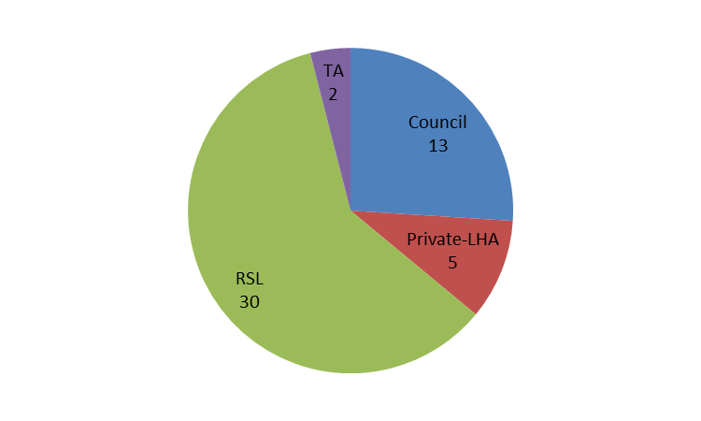
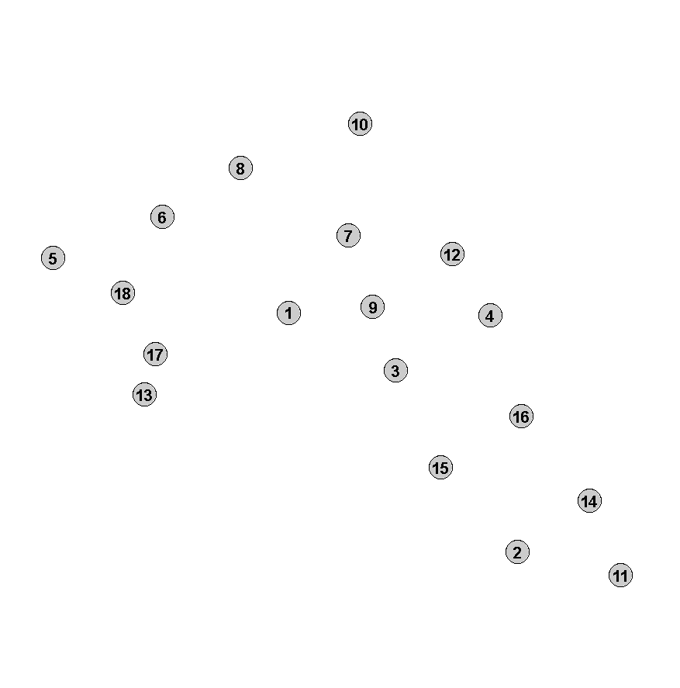

“18-21 year-olds on Jobseeker’s Allowance will no longer have an automatic entitlement to housing benefit”
50 18-21 year olds in Camden claiming HB & JSA
By tenure
By ward
Belsize
Bloomsbury
Camden Town with Primrose Hill
Cantelowes
Fortune Green
Frognal and Fitzjohns
Gospel Oak
Hampstead Town
Haverstock
Highgate
Holborn and Covent Garden
Kentish Town
Kilburn
King's Cross
Regent's Park
St. Pancras and Somers Town
Swiss Cottage
West Hampstead
Who might be exempt?
Households with children – 3 in borough
People with disabilities – 3
Households in TA - 2
0
1
2
3
4+
Data as of 21 May 2015

