Slide 1
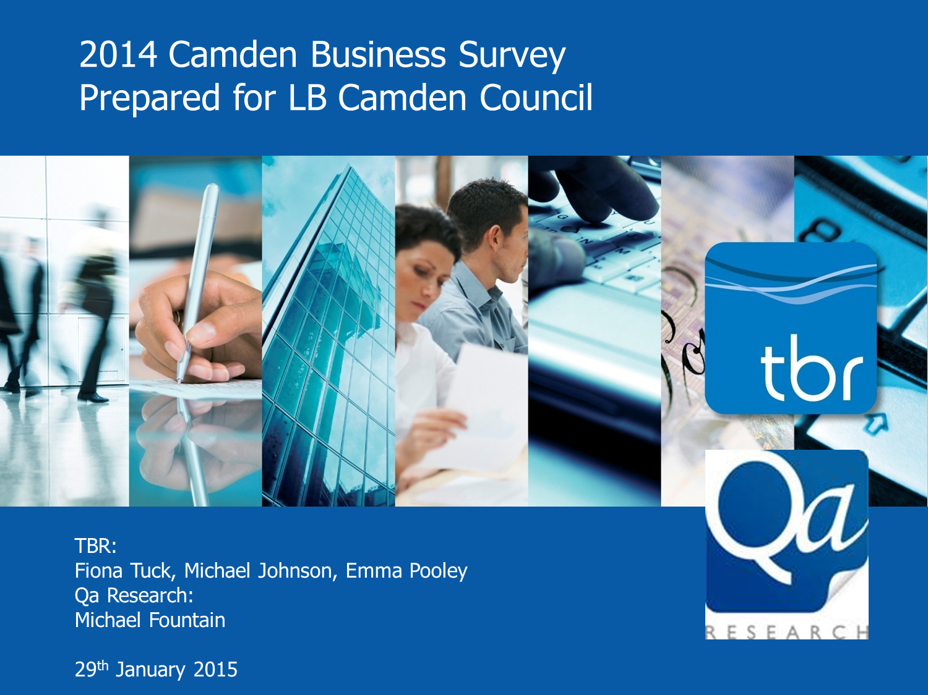
Camden Business Survey 2014 - The Results
Summary of key findings
22.04.2015

Slide 2


Background to the survey
Key objectives:
Follow on from 2012 survey.
Performance management against Camden Plan.
Understand key issues and challenges facing Camden’s businesses.
Use survey findings to guide policy direction and resources.
Engage with local businesses.
What we did :
Commissioned TBR and QA consultants.
Carried out 400 telephone surveys.
Used a random sample which was reflective of business community by sector and size.
Analysed the data and produced a final report.

Slide 3
Topics
Headline findings
Business activity
Camden as a place to do business
The role of the Council
Council contact
Opportunities and issues for businesses
Skills and recruitment
Employment support and Corporate Social Responsibility
Follow-up: Contacting businesses
Implications for the Business Charter

Slide 4
Headline Findings
Camden is a good place to do business:
Two thirds (67%) of respondents felt that Camden was a good or excellent place to do business in 2014; an increase of 6 percentage points from 2012.
Good transport links, amenities for workers and quality of local environment:
Are the top strengths of the area. Parking, cost and availability of premises and speed of internet connection are the top weaknesses.
Business activity in the borough is stabilising and optimism remains strong:
77% of firms stable or experiencing growth over the last 12 months and a reduction in businesses experiencing a drop in activity.
The general economic conditions remains the greatest challenge for businesses:
Although to a lesser extent than in 2012. Potential for expansion remains the most frequently reported opportunity.
Business friendliness of the Council is stable but slightly more polarised:
36% friendly, 43% neutral, 22% unfriendly.
Satisfaction with Council contact high at 60%:
But down from 70% in 2012.
Businesses are finding it easier to recruit people with the right skills:
72% reporting no difficulties.
Businesses are engaging in more employment support and CSR activities:
Many are interested in finding out more. We are contacting businesses to take this forward.

Slide 5
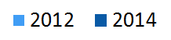
Headline Findings - Business activity
Business activity- last 12 months
Business activity in Camden is stabilising:
Change in Activity | 2012 | 2014
Lower/much lower | 31% | 21%
The same | 34% | 42%
Higher/much higher | 34% | 35%
Employment levels showing little change:
Employment | 2012 | 2014
Lower/much lower | 14% | 13%
The Same | 72% | 72%
Higher/much higher | 13% | 13%
Business optimism about the future is high, but down on 2012:
Expected Activity | 2012 | 2014
Lower/much lower | 7% | 9%
The Same | 29% | 33%
Higher/much higher | 58% | 46%

Slide 6
Headline Findings - Camden as a place to do business
Camden as a place to do business
Issues important to businesses
67% of businesses think Camden is a good or excellent place to do business - increase of 6% on the 2012 results. Largest increase was in excellent.
Top priorities - good transport links, speed of internet connection and quality of local environment.

Slide 7
Headline Findings- Camden as a place to do business
Strengths and weaknesses of the borough
The longer the line in blue, the more frequently that factor was considered a strength. The longer the line in red, the more frequently the factor was considered a weakness
Good transport links is the most significant strength of the area
Parking and cost, availability of business premises and speed of internet connection the most significant weaknesses.

Slide 8
Headline Findings- The role of the Council
Business friendliness of the Council
Business Friendliness | 2012 | 2014
Business Unfriendly | 17% | 22%
Neither friendly/unfriendly | 50% | 43%
Business Friendly | 34% | 36%
Businesses friendliness stable but slightly more polarised than in 2012
Business unfriendly | Business friendly
Business rates too high | Communication with the council has always been helpful
Not interested in businesses | Council services and initiatives have always been positive
Do not resolve queries | The council works well with businesses
Businesses were asked why they gave their score. Here are the most frequent responses:

Slide 9
Headline Findings - Council contact
Percentage of businesses that had contact with Council in the last two years:
Reported satisfaction with service:
Satisfaction with the service received by those that had contacted the Council:
Satisfied | 2012 | 2014
Satisfied (3-5) | 70% | 60%
Dissatisfied (1-2) | 25% | 35%

Slide 10
Headline Findings - Opportunities and issues for businesses
The most common challenges and opportunities for businesses
Challenges | Opportunities
Overall Economic conditions (15%) Cost of premises (11%) Availability of premises (9%) Access to finance (8%) Parking (8%) Volume of business - clients or customers (6%) Increasing UK market competition (5%) | Expand the business (12%) Find more business (6%) Marketing (5%) Concentrate on international growth (3%) Investment or funding (3%) Diversifying into new areas of business (2%) It depends on the actions of the public sector, council or government (2%)

Slide 11
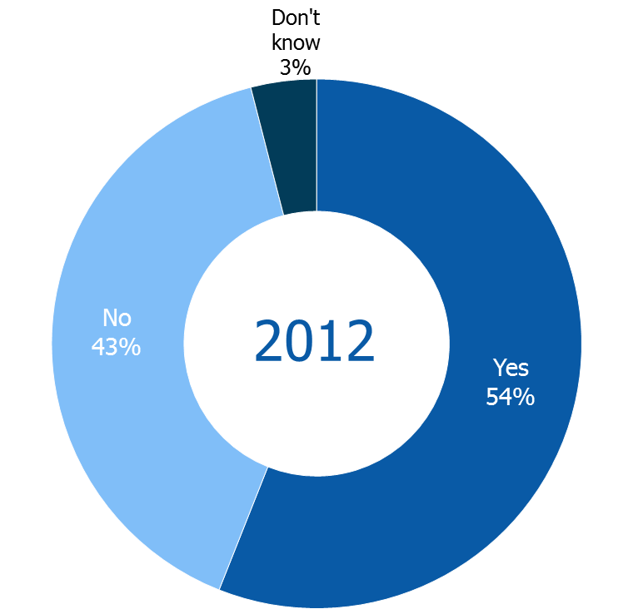
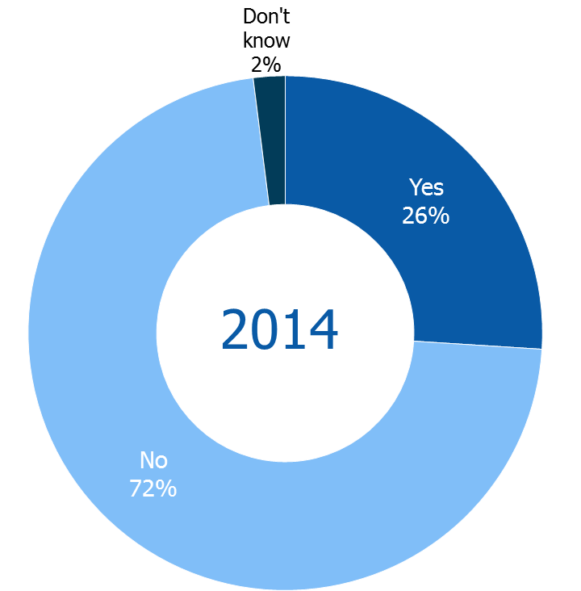
Headline Findings - Skills & recruitment
Prominence of difficulties recruiting staff with the right skills
Difficulties recruiting staff with right skills significantly reduced
Skills gaps in existing workforce remain stable on 2012 figures

Slide 12
Headline Findings- Skills & recruitment
5 skills most frequently absent amongst young people
2012 | 2014
Written communication (32%) Attitude/work ethic (29%) Oral Communication (26%) Literacy Skills (24%) Advanced IT/software (19%) | Attitude/work ethic (18%) Oral Communication (17%) Customer Handling (12%) Suitable work experience (12%) Technical/Practical Skills (10%)
Businesses identified fewer deficiencies in 2014 than in 2012.
The Financial & Insurance Services sector least likely to identify absent skills.
International companies with premises outside of UK also less likely to report deficiencies.
Science sector more likely than other growth sectors to experience skills issues with young recruits/applicants, particularly in respect of advanced IT/software skills and technical or practical skills.

Slide 13
Headline Findings – Employment support and CSR
Employment support currently offered
Significant increase in firms offering employment support (e.g. apprenticeships, flexible working) and CSR (Corporate Social Responsibility).
36% interested in offering further employment support activities.
29% interested in finding out more about CSR.
CSR currently offered

Slide 14
Follow-up - Contacting Businesses
Many businesses requested further information on Council and partner initiatives that support local businesses. Those initiatives included:
Camden Apprenticeships – helping businesses set up apprenticeship schemes
and residents find apprenticeship opportunities
CompeteFor – assisting businesses compete for contract opportunities
Corporate Social Responsibility – supporting businesses meet CSR objectives
London Living Wage – championing the benefits of a living wage for businesses and society
Timewise – promoting the adoption of flexible working and supporting residents in finding flexible employment

Slide 15
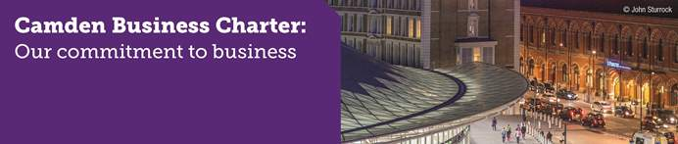
Implications for the Business Charter
The Business Survey helps us measure our progress in meeting the commitments within the Business Charter
67% of businesses saying that Camden is a good or excellent place to do business is a positive position to build on.
Camden strengths: Transport links, local environment and amenities.
Camden weaknesses: Cost/availability of premises, internet and parking.
Drop in satisfaction with how Council dealing with business customer queries needs to be addressed.
Increased willingness for participation and employment support connecting businesses with the local community.
Find out more about our commitment to business.

